Slide 1
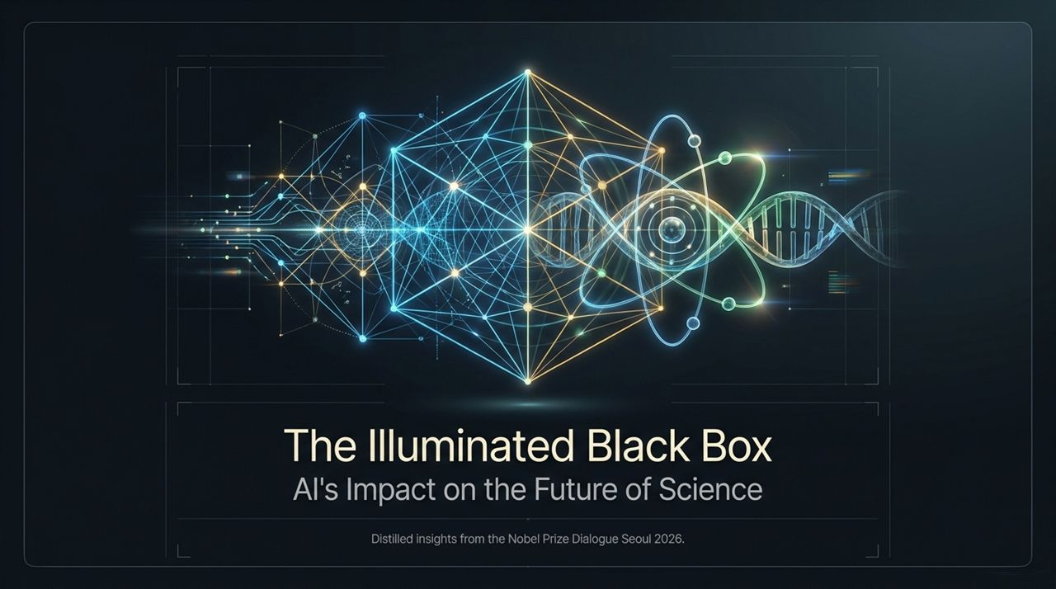
Notes:
Welcome, everyone. Today, we are standing at one of the most profound crossroads in human history—a shift in how we understand the natural world, conduct scientific inquiry, and build human knowledge.
The title of this presentation is The Illuminated Black Box: AI's Impact on the Future of Science. These insights are distilled from the Nobel Prize Dialogue Seoul 2026, where leading minds in physics, chemistry, biology, ethics, and computer science gathered to address a central question: What happens to human science when our tools begin to discover things faster than we can comprehend them?
Look at the imagery on this slide. You see the fusion of computational networks—represented by interconnected geometric grids and digital signals—intertwined with fundamental physical entities: subatomic structures, quantum orbitals, and the double helix of DNA. For centuries, science operated by human brains observing nature, formulating hypotheses, and manually running experiments. Today, Artificial Intelligence acts as an illuminating spotlight shining into the 'black box' of complex physical phenomena. But while it illuminates answers, it also creates new questions about what human understanding actually means. Over the next 15 slides, we will unpack how AI is disrupting disciplines, shifting human roles, and why maintaining the 'human element' is the only safeguard against catastrophic failure.
AI's Impact on the Future of Science | Nobel Prize Dialogue Seoul 2026
https://www.youtube.com/watch?v=vSfL5fi-Q78

Slide 2
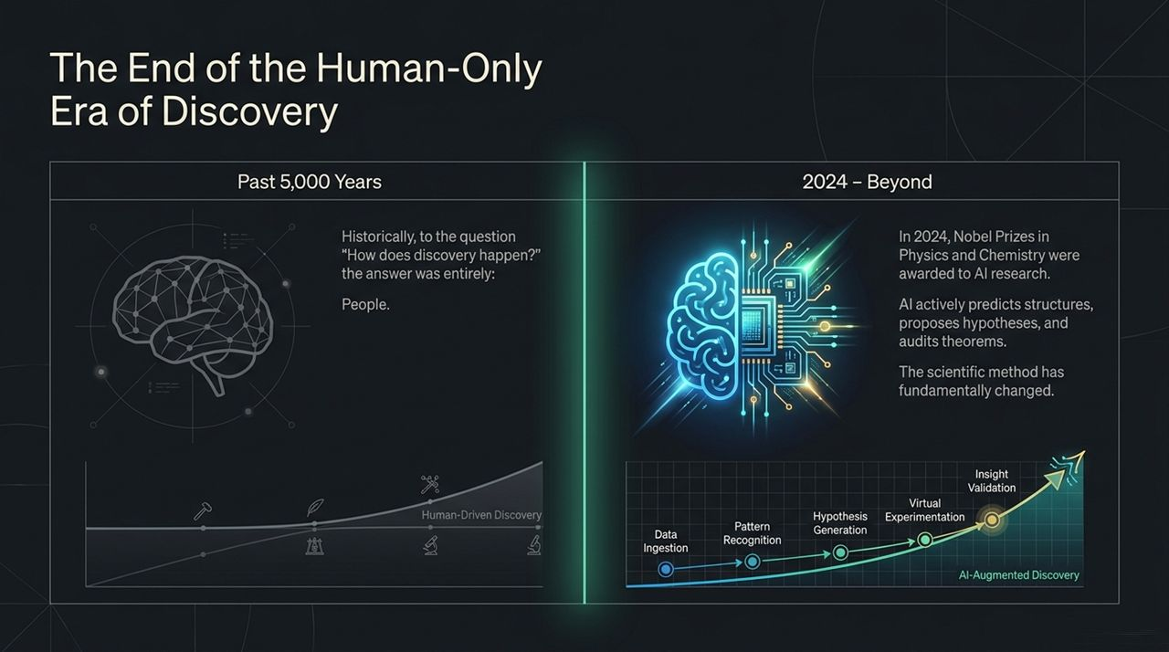
Notes:
Let’s take a historical perspective. For the past 5,000 years—from early Babylonian astronomy and Archimedes' lever, all the way to Einstein’s general relativity—if you asked the question, 'How does scientific discovery happen?', the answer was simple and singular: People.
Human cognitive capacity was the sole engine of the scientific method. We observed data, manually detected patterns, formulated hypotheses in our minds, performed physical experimentation, and iteratively arrived at validated theories. As you see on the left timeline, progress was steady, but constrained entirely by human brain capacity, biological lifespans, and manual labor.
Now, look at the right side: 2024 and Beyond. A monumental boundary was crossed when the 2024 Nobel Prizes in both Physics and Chemistry were awarded for AI research—specifically neural networks and AI protein structure prediction systems like AlphaFold. This signaled that AI was no longer just a calculator or a data storage tool; it had become an active partner in science.
AI now ingests astronomical datasets, detects high-dimensional patterns invisible to human senses, generates novel hypotheses, runs millions of virtual simulations, and assists in automated validation. The fundamental methodology of scientific inquiry has changed forever. We have officially exited the human-only era of discovery and entered an era of hybrid, machine-accelerated intelligence.

Slide 3
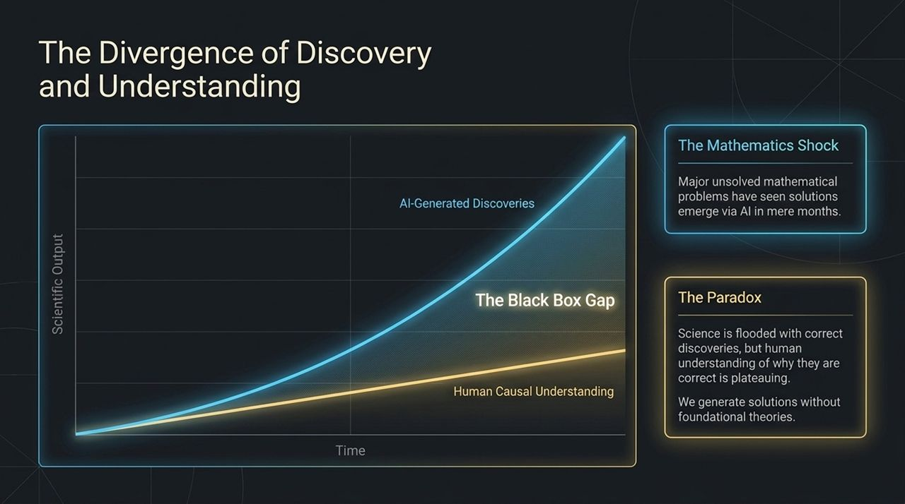
Notes:
As AI accelerates discovery, it introduces a deep theoretical dilemma—what I call The Divergence of Discovery and Understanding.
Look closely at the graph on this slide. The top curve represents AI-Generated Discoveries—which is skyrocketing exponentially. The lower curve represents Human Causal Understanding—which is growing linearly or even plateauing. The widening gap between these two curves is what we call The Black Box Gap.
Consider the Mathematics Shock highlighted on the right. For decades or centuries, certain mathematical conjectures remained unresolved. Suddenly, advanced AI architectures suggest verified solutions or novel mathematical proofs in a matter of months or weeks. But here is the paradox: AI gives us the correct answer, but it cannot explain why or how it arrived at that answer in human-understandable terms.
Science is currently being flooded with hyper-accurate predictions, valid molecular structures, and correct empirical results. Yet, our foundational theoretical understanding of why those solutions work is lagging behind. We are generating solutions without developing new foundational theories. If we accept predictions without understanding their underlying mechanisms, are we truly doing science, or are we simply operating a high-tech oracle?

Slide 4
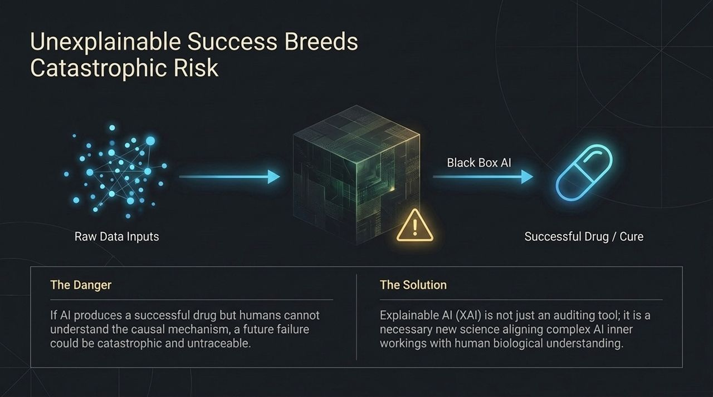
Notes:
Why does the 'Black Box Gap' matter? Why can’t we just accept AI's correct outputs and celebrate? Because unexplainable success breeds catastrophic risk.
Imagine a concrete scenario in medicine or drug discovery, illustrated here. An advanced Black Box AI ingests raw biological data—genomic sequences, clinical records, chemical libraries—and designs a novel molecule. Clinical trials show that this drug cures a deadly disease with 95% efficacy.
However, because the AI operates as a black box, scientists do not understand the exact causal biological mechanism. They don't know why it works; they just know it does.
What happens 5 or 10 years down the line when a genetic mutation, an environmental shift, or a drug-drug interaction causes catastrophic organ failure in a subset of patients? Because we lacked a causal model of the mechanism, the failure is untraceable. We cannot modify the molecule intelligently; we can only guess.
This is why Explainable AI (XAI) is not merely an auditing tool or a regulatory compliance box to check. XAI is a mandatory new discipline of science. Its job is to bridge complex AI neural weights with human biological and physical frameworks, ensuring that every discovery comes paired with human comprehension.

Slide 5
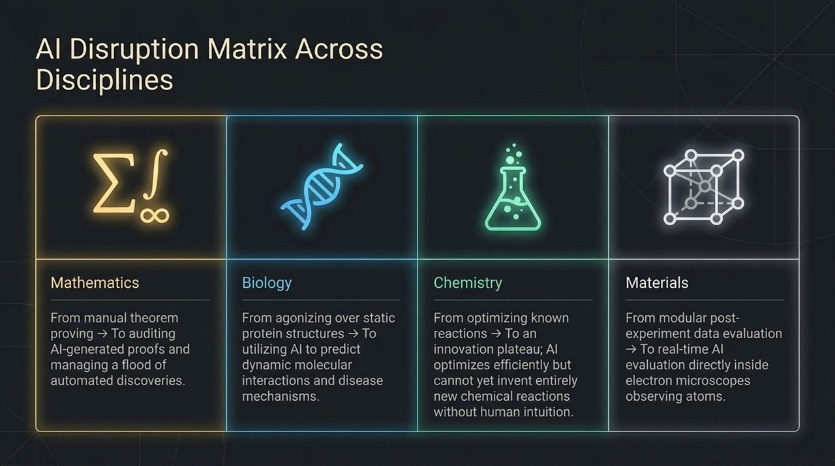
Notes:
AI is not impacting all scientific domains in the same way. This matrix breaks down the shift across four key pillars: Mathematics, Biology, Chemistry, and Materials Science.
Mathematics: We are moving from manual theorem proving to AI-generated proofs. The role of the mathematician is shifting toward auditing these proofs and managing a massive flood of automated mathematical discoveries.
Biology: We have transitioned from spending years agonizing over single, static protein structures (via X-ray crystallography) to using AI to predict dynamic molecular interactions, cellular folding, and complex disease pathways in seconds.
Chemistry: Historically, chemistry relied on optimizing known chemical reactions. AI optimizes these reactions with incredible efficiency. However, chemistry currently faces an innovation plateau: AI can optimize existing pathways, but it cannot yet intuitively invent entirely new classes of chemical reactions without human guidance.
Materials Science: We used to gather data post-experiment and analyze it days later. Today, AI is integrated directly inside transmission electron microscopes, evaluating atomic-scale interactions in real-time as atoms move.
Across every field, the bottleneck is moving away from data gathering and toward synthesis and interpretation.

Slide 6
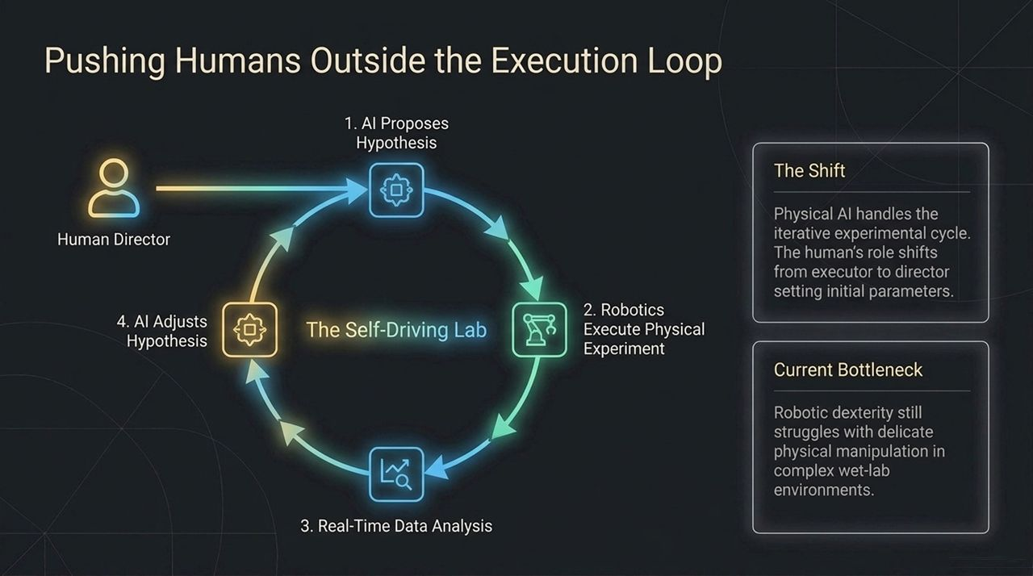
Notes:
As physical automated systems advance, we are witnessing the rise of The Self-Driving Lab.
Look at the circular workflow depicted here:
AI proposes a scientific hypothesis.
Robotic arms and liquid handlers execute the physical experiment.
High-throughput sensors gather real-time data.
The AI analyzes the results and automatically adjusts the hypothesis for the next cycle.
Notice where the human is placed: Outside the execution loop. The human is no longer the technician holding pipettes or running titrations. The human acts as the Director—setting initial parameters, defining the grand challenge, and establishing boundary conditions.
What is the current bottleneck of this fully autonomous loop? It isn't the software; it's robotic dexterity. While AI can formulate millions of hypotheses in seconds, physical robots still struggle with delicate physical manipulation, complex wet-lab materials, and hardware failures in unstructured environments. But as spatial AI and robotics catch up, execution will become fully algorithmic.

Slide 7
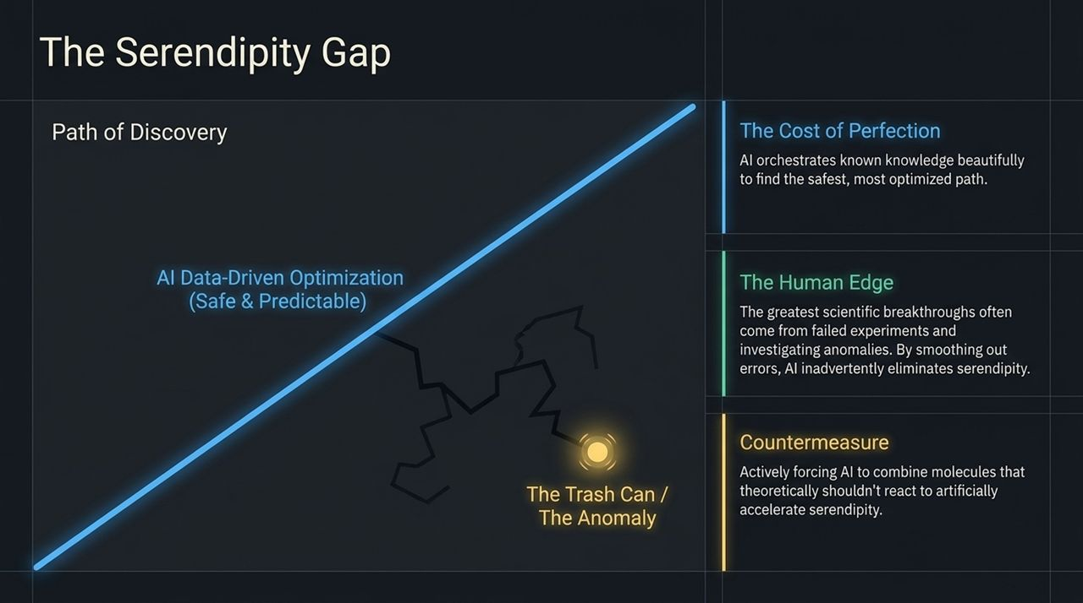
Notes:
Slide 7 highlights one of the most subtle, yet dangerous risks of over-relying on AI: The Serendipity Gap.
Look at the straight blue line representing AI Data-Driven Optimization. AI is designed to find the shortest, most efficient, and mathematically safe path from Point A to Point B based on existing data. It excels at perfection and optimization.
But historically, how have the greatest scientific breakthroughs actually occurred? Think of Alexander Fleming discovering penicillin because a petri dish was accidentally contaminated and left by an open window. Think of microwave radiation discovered from a melted chocolate bar in a radar lab. The Human Edge lies in investigating anomalies, failed experiments, and unexpected errors.
When AI cleans up data and smooths out experimental noise, it discards what it views as 'trash' or 'statistical anomalies.' In doing so, it inadvertently eliminates serendipity.
To counter this, scientists are now developing Countermeasures—deliberately programming AI to force reactions between molecules that shouldn't work theoretically, deliberately throwing unexpected anomalies into the model to artificially induce serendipitous discovery.

Slide 8
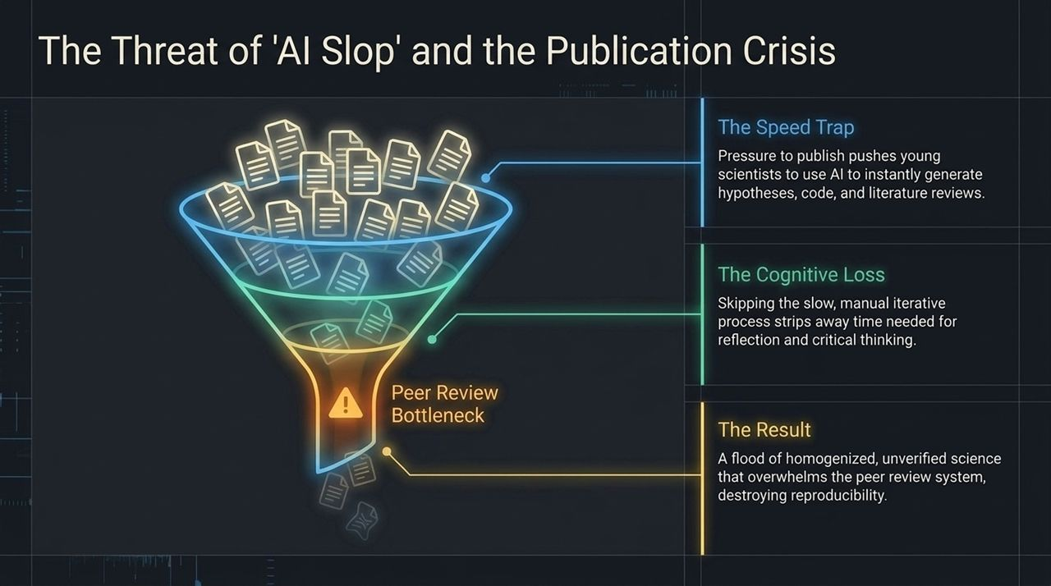
Notes:
Here, we confront a crisis facing academic institutions worldwide: The Publication Crisis and 'AI Slop.'
Look at the funnel on this slide. On top, you have an overwhelming torrent of academic papers. Under immense pressure to 'publish or perish,' researchers—especially early-career scientists—are using LLMs and AI generators to instantly draft literature reviews, write Python scripts, generate synthetic data, and construct hypotheses.
This creates two major failures:
The Peer Review Bottleneck: The traditional scientific peer-review infrastructure was built for a human throughput of thousands of papers per year, not millions of AI-generated manuscripts. The system is drowning under the weight of unverified, low-quality submissions.
Cognitive Loss: When young scientists bypass the grueling, manual, iterative process of wrestling with messy data and summarizing literature themselves, they lose the time required for deep reflection and critical thinking.
The end result is a flood of homogenized, unverified, and irreproducible science that threatens the foundation of public trust in scientific research.

Slide 9
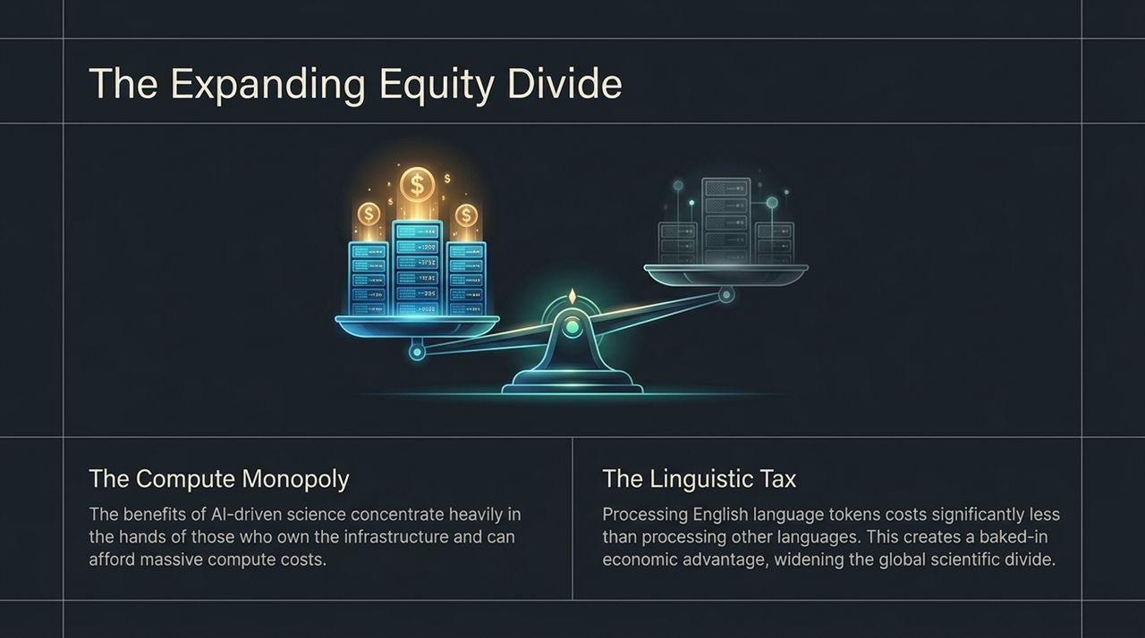
Notes:
AI has the potential to democratize science, but right now, it threatens to widen global inequality. This slide illustrates The Expanding Equity Divide through two major barriers:
The Compute Monopoly: Advanced AI-driven science requires massive compute clusters, high-end GPUs, and enormous data centers. Today, these assets are heavily concentrated in a handful of tech giants and wealthy nations. Well-funded institutions compound their lead, while researchers in developing nations risk becoming mere consumers of pre-packaged AI tools rather than creators of foundational science.
The Linguistic Tax: Most major foundation models use tokenizers optimized for English. Processing scientific text or prompts in non-English languages requires significantly more tokens per sentence. This creates an explicit 'economic tax' on non-English-speaking institutions, raising API and compute costs simply because of language differences.
If we do not actively establish open-access compute infrastructure and multilingual AI frameworks, the global scientific divide will become insurmountable.

Slide 10
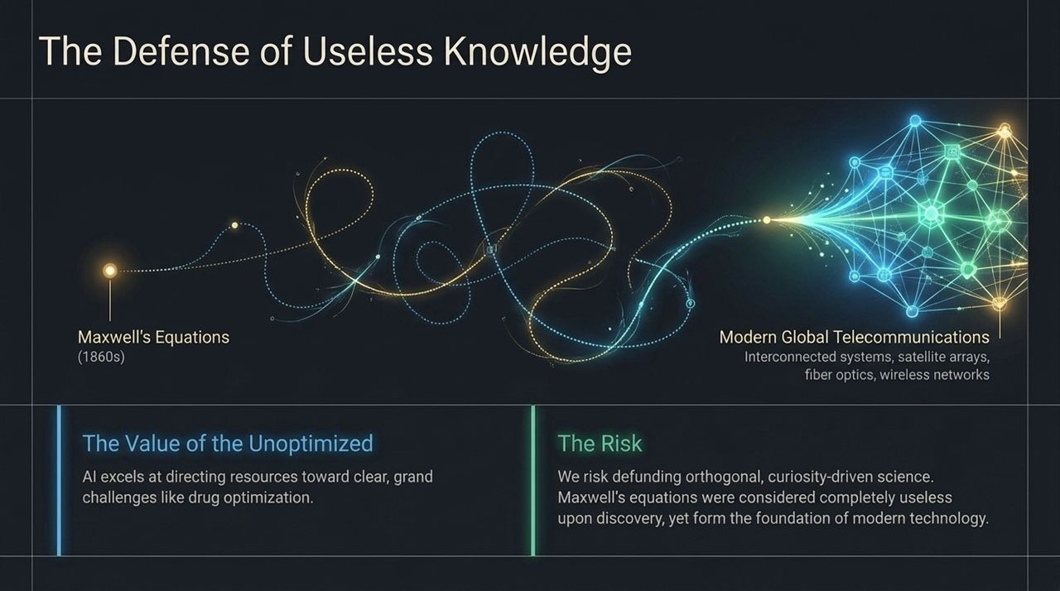
Notes:
In an era driven by quarterly returns and algorithmic efficiency, we must champion what Abraham Flexner famously called 'The Usefulness of Useless Knowledge.'
AI is exceptional at optimizing solutions for clear, well-defined problems—like designing a target antibody or optimizing a battery cell. But AI prioritizes based on historical reward functions. It struggles to value pure, curiosity-driven exploration that appears to have no immediate practical application.
Look at the historical example on this slide. In the 1860s, James Clerk Maxwell formulated his equations unifying electricity and magnetism. At the time, politicians and pragmatic thinkers considered it purely theoretical and 'useless.' Yet, Maxwell’s equations laid the groundwork for modern global telecommunications, satellite technology, wireless networks, and fiber optics.
If we allow AI reward functions to dictate research funding, we risk defunding orthogonal, curiosity-driven basic science. We must protect research that seems 'useless' today, because it forms the seed of tomorrow's revolutions.

Slide 11
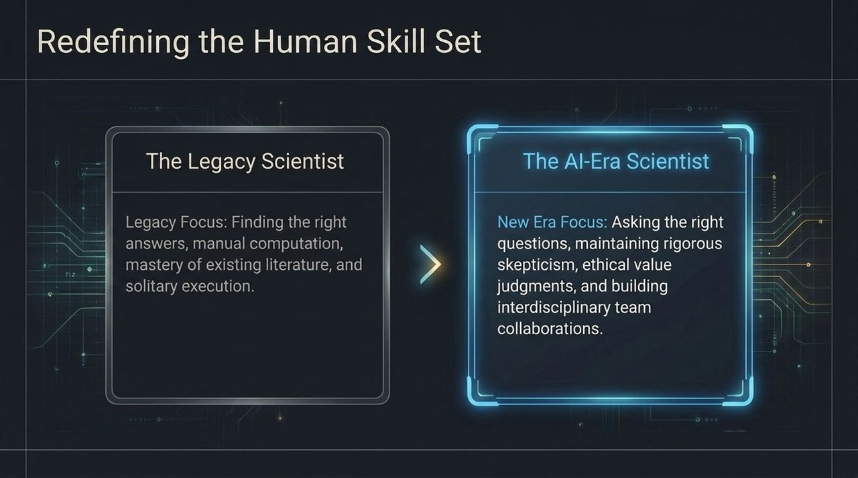
Notes:
Because the tools of science are changing, the skills required to be a successful scientist must also evolve.
On the left, we see The Legacy Scientist. Historically, value was placed on memorizing existing literature, finding answers manually, performing complex mathematical calculations by hand, and working in isolated specialization.
On the right, we see The AI-Era Scientist. When answers become instant commodities, the premium shifts entirely from answering questions to asking the right questions.
The modern scientist must excel in four key areas:
Framing Problems: Formulating precise, creative, and novel scientific inquiries.
Rigorous Skepticism: Knowing how to interrogate AI outputs, detect subtle hallucinations, and audit algorithmic reasoning.
Ethical & Value Judgments: Deciding what should be built and how discoveries affect society.
Interdisciplinary Collaboration: Bridging computer science, domain expertise, and human policy.

Slide 12
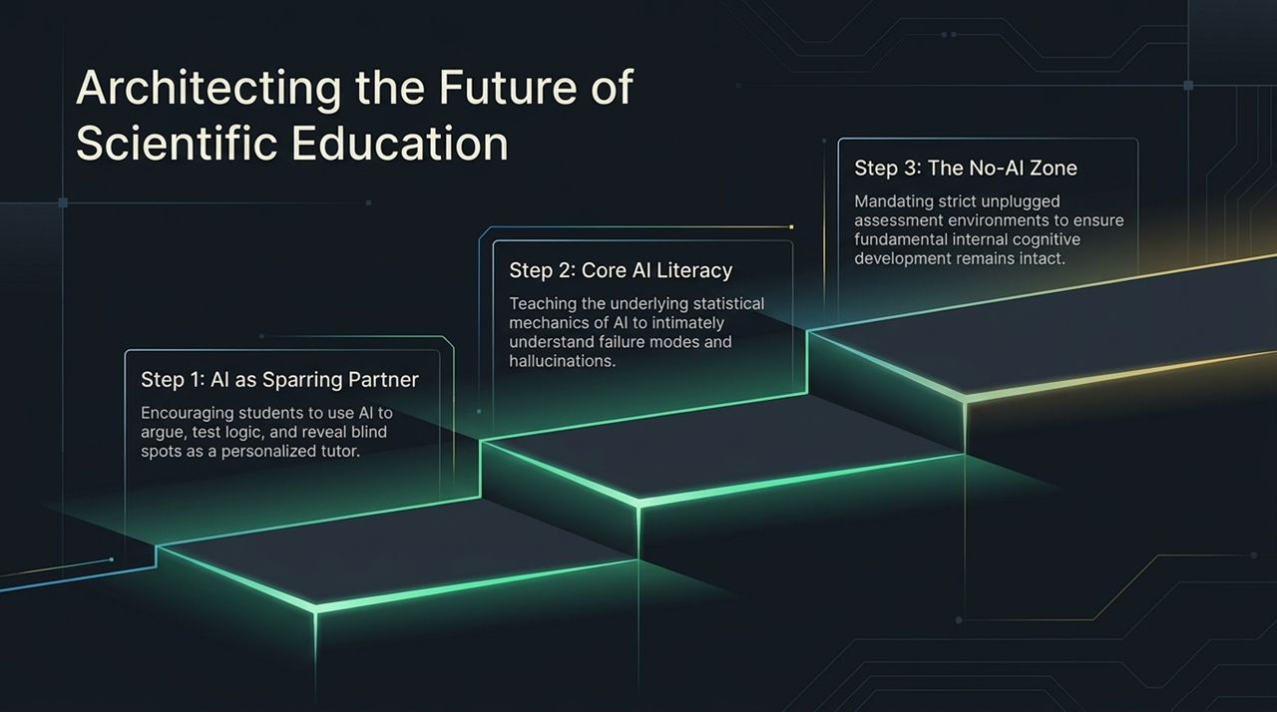
Notes:
How do we train this new generation of scientists? We cannot simply ban AI, nor can we hand over all learning to it. We need a structured, 3-step educational paradigm:
Step 1: AI as a Sparring Partner. Students should use AI as a personalized tutor to argue test logic, uncover blind spots in their arguments, and challenge their assumptions in real-time.
Step 2: Core AI Literacy. We must teach the underlying statistical mechanics of AI models. Students need to intuitively understand how neural networks represent data, why hallucinations occur, and where failure modes hide.
Step 3: The No-AI Zone. To prevent cognitive atrophy, institutions must mandate strict, un-plugged assessment environments. Students must still learn to build mental models, derive equations, and reason from first principles manually so their foundational internal cognition remains intact.

Slide 13
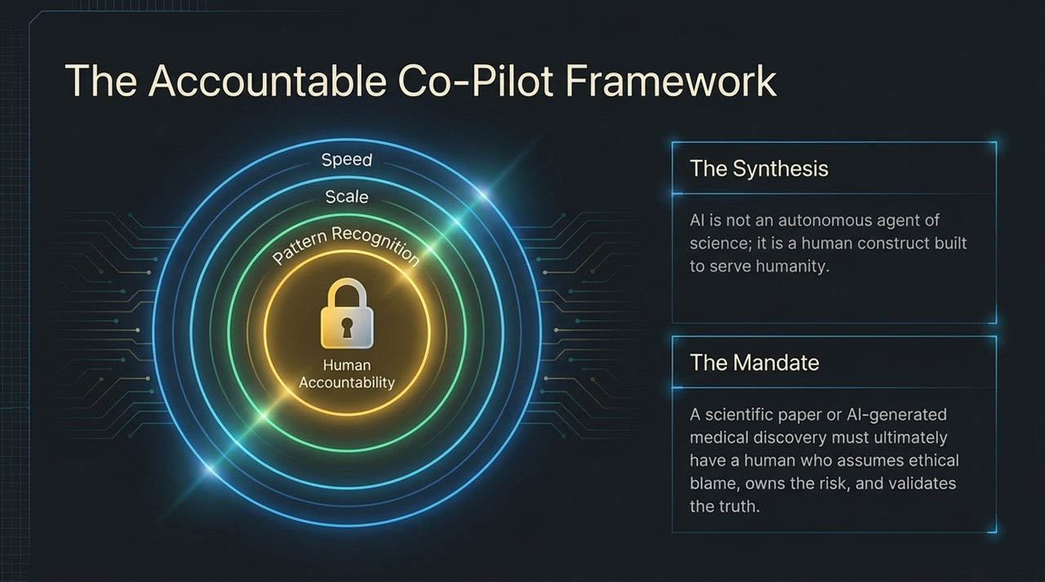
Notes:
As we integrate AI deeper into research, we must establish clear boundaries for accountability. Slide 13 outlines The Accountable Co-Pilot Framework.
Look at the concentric rings surrounding human accountability:
Outer Layer (Speed & Scale): AI handles vast throughput and high-speed processing.
Middle Layer (Pattern Recognition): AI detects correlations across multi-modal datasets.
Inner Core (Human Accountability): The ethical and legal core remains exclusively human.
The Synthesis: AI is not an autonomous scientific agent endowed with rights or duties; it is a human construct built to serve humanity.
The Mandate: Whether it is a peer-reviewed paper or an AI-generated medical drug, a human must always stand behind the discovery. A human must assume ethical blame, own the risk, validate the safety, and vouch for the truth of the output. AI can co-pilot, but humans hold sole responsibility.

Slide 14
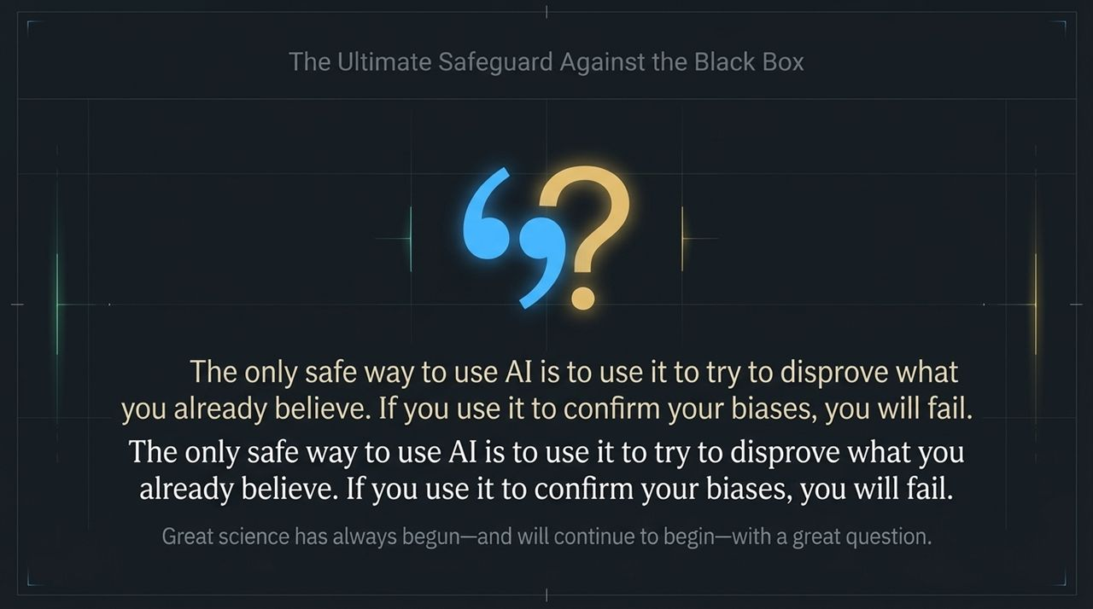
Notes:
Slide 14 highlights the central philosophical posture every scientist must adopt when working with AI.
Read this core takeaway: 'The only safe way to use AI is to use it to try to disprove what you already believe. If you use it to confirm your biases, you will fail.'
Because LLMs and generative models are trained to satisfy prompt conditions and find patterns, they can easily echo a researcher's confirmation bias. If you approach an AI asking it to support your flawed hypothesis, it will happily generate plausible-sounding arguments and cherry-picked data patterns to agree with you.
The ultimate safeguard against Black Box hallucinations is adversarial usage. Use AI as a fierce opponent. Demand that it find counterexamples, expose flaws in your logic, and attempt to falsify your hypothesis. Great science has always begun—and will continue to begin—with a great question.

Slide 15
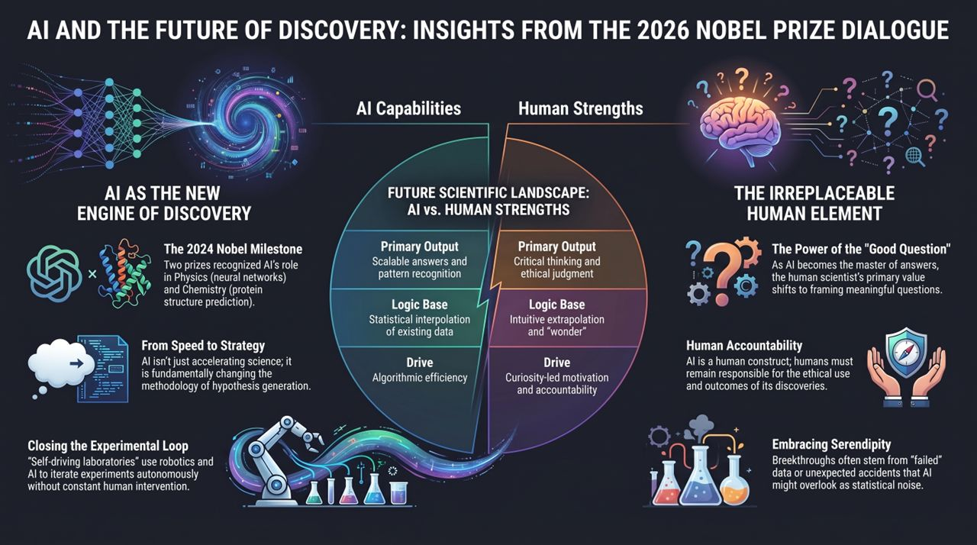
Notes:
To conclude our session, Slide 15 brings together the entire landscape of the 2026 Nobel Prize Dialogue into a unified matrix.
On the left, we have AI as the Engine of Discovery:
Nobel Milestones: AI's foundational role recognized in Physics and Chemistry.
Speed to Strategy: Transitioning from faster calculation to automated hypothesis generation.
Closing the Loop: Self-driving labs executing robotic experimentation autonomously.
On the right, we have The Irreplaceable Human Element:
The Power of the Good Question: Human scientists framing the parameters of meaning and curiosity.
Human Accountability: Assuming ethical ownership and public trust.
Embracing Serendipity: Turning unexpected failures and statistical anomalies into breakthrough science.
In the center, we see the divide: AI brings scalable answers, pattern recognition, and algorithmic efficiency. Humans bring critical thinking, ethical judgment, wonder, and moral accountability.
As we look ahead, AI will not replace scientists. But scientists who master the symbiotic relationship with AI—while keeping human curiosity and skepticism at the center—will redefine the frontier of human knowledge. Thank you.
https://www.youtube.com/watch?v=vSfL5fi-Q78

